Slide 1
Pitchfork
Ian Pearlstein
DJ Bonifacic

Slide 2
Roc Nation
Hello Roc Nation! We’d like to thank you for having us today and letting us present to you our research in the music industry. We know that it takes a lot of time and money to find great talent. We hope our data and resource library helps you find the next Jay-Z and Beyoncé.

Slide 3


Our Resource Library
We have created a site that gives the user the ability to search for a specific band and find interesting facts and figures.
Album history
Ratings of Albums
Genre Ratings over time

Slide 4
Methodology
Kaggle SQLite database of 20k album reviews from 1999-2017
Contained the following tables: Reviews, Artists, Genres, Year
Pandas to merge tables in SQLite database to easily call in Flask routes
Used Flask and SQLAlchemy to query the database and convert the dataframes into JSON objects in app.py file
Used D3 and JQuery to load the JSON objects into dynamic tables and plots (app.js file)
HTML template for front end and for D3 to call tags (index.html file)

Slide 5
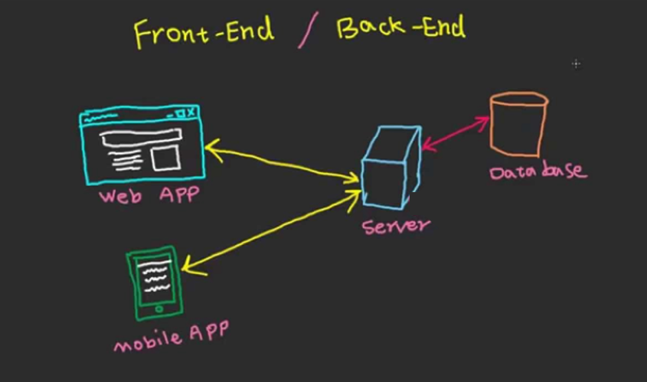
How it’s built

Slide 6
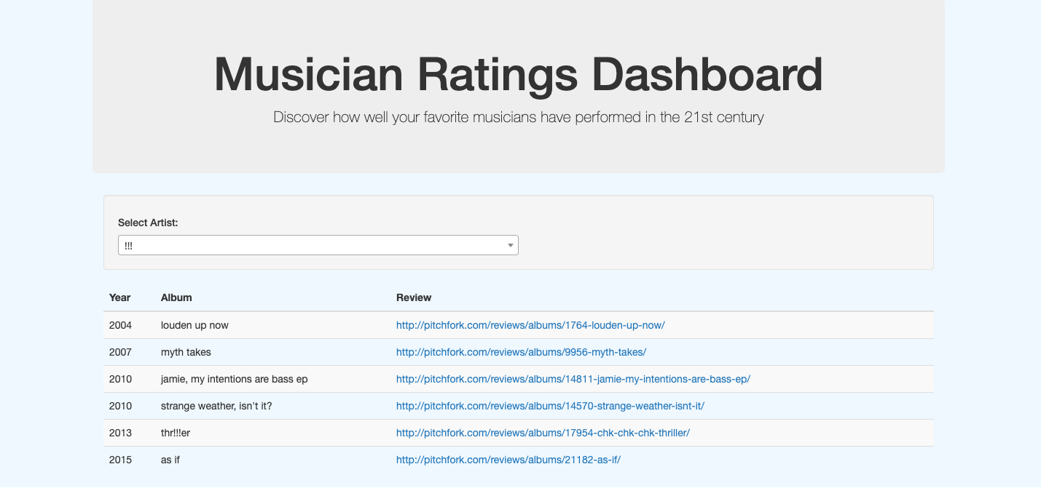
Live Demo

Slide 7
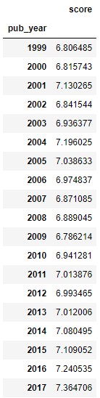
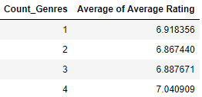
Our Findings
Overall music ratings have increased over the years.
2000 - 2009 average score: 6.95
2010 - 2017 average score: 7.09
Artists with more genres tend to have higher scores on their work

Slide 8
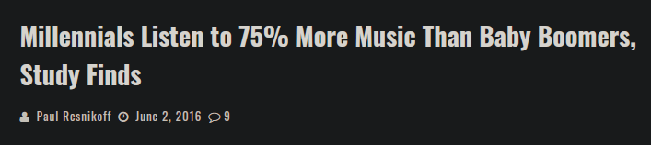
Our Recommendation
Focus on millennials. It’s not about what you think sounds good. It’s about the customer.
Find artists that can work in multiple genres. They tend to have higher ratings.

